Slide 1
The IDEA Matrix

Slide 2


Why ?
To Transform Concepts Into Reality

Slide 3



Invest less Innovate More!
Invest,
Invent
Innovate

Slide 4


D
Discover
Document
Define
Decrease

Slide 5
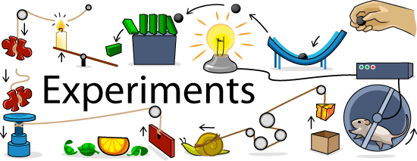

E
Experiment,
Experience
Evaluate

Slide 6
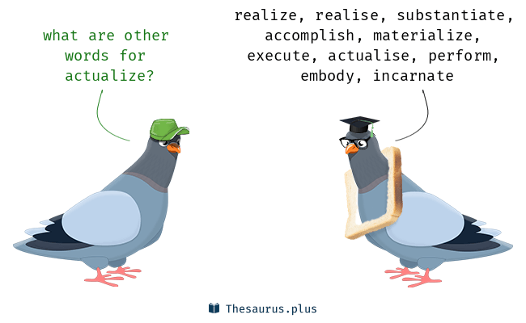


A
Actualize
Advance
Advertize

Slide 7
MORE ON idea concept…..
http://www.isixsigma.com/implementation/project-selection-tracking/select-projects-using-evaluation-and-decision-tools/
Knowledge Innovation Strategy
Dr. Parag Kulkarni

Slide 8
Thank you !

